Slide 1

Home Page
Notes:
image
No alt text provided
image
No alt text provided
image
No alt text provided
textbox
No alt text provided
textbox
No alt text provided
textbox
No alt text provided
textbox
No alt text provided
image
No alt text provided
textbox
No alt text provided
image
No alt text provided

Slide 2
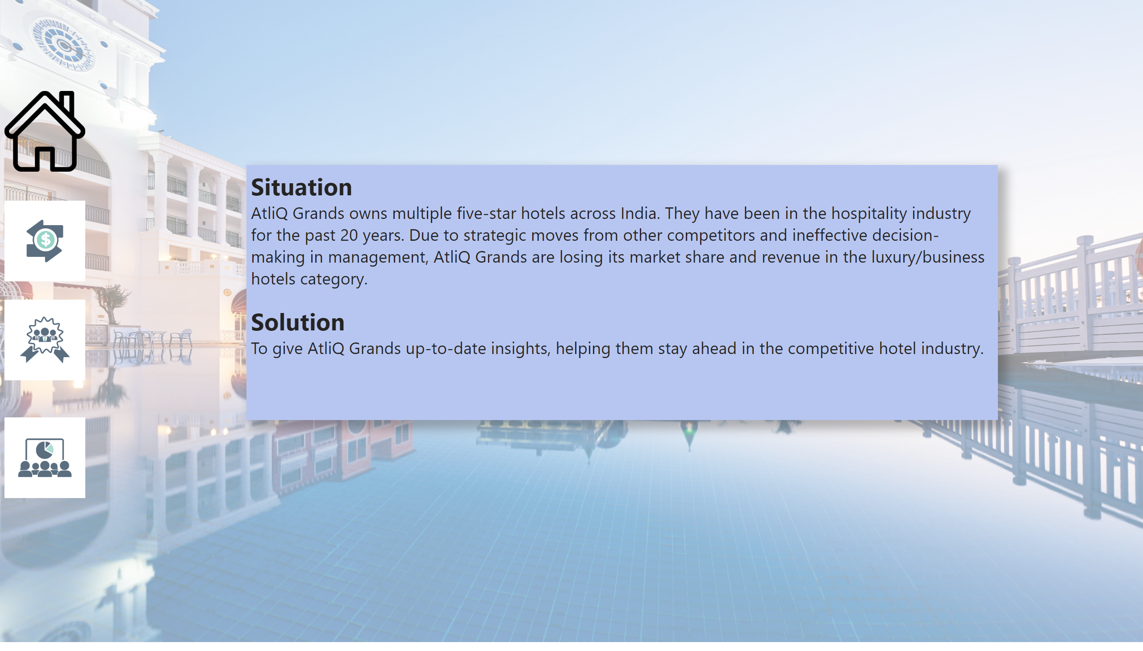
Problem Statement
Notes:
textbox
No alt text provided
image
No alt text provided
image
No alt text provided
image
No alt text provided
image
No alt text provided

Slide 3
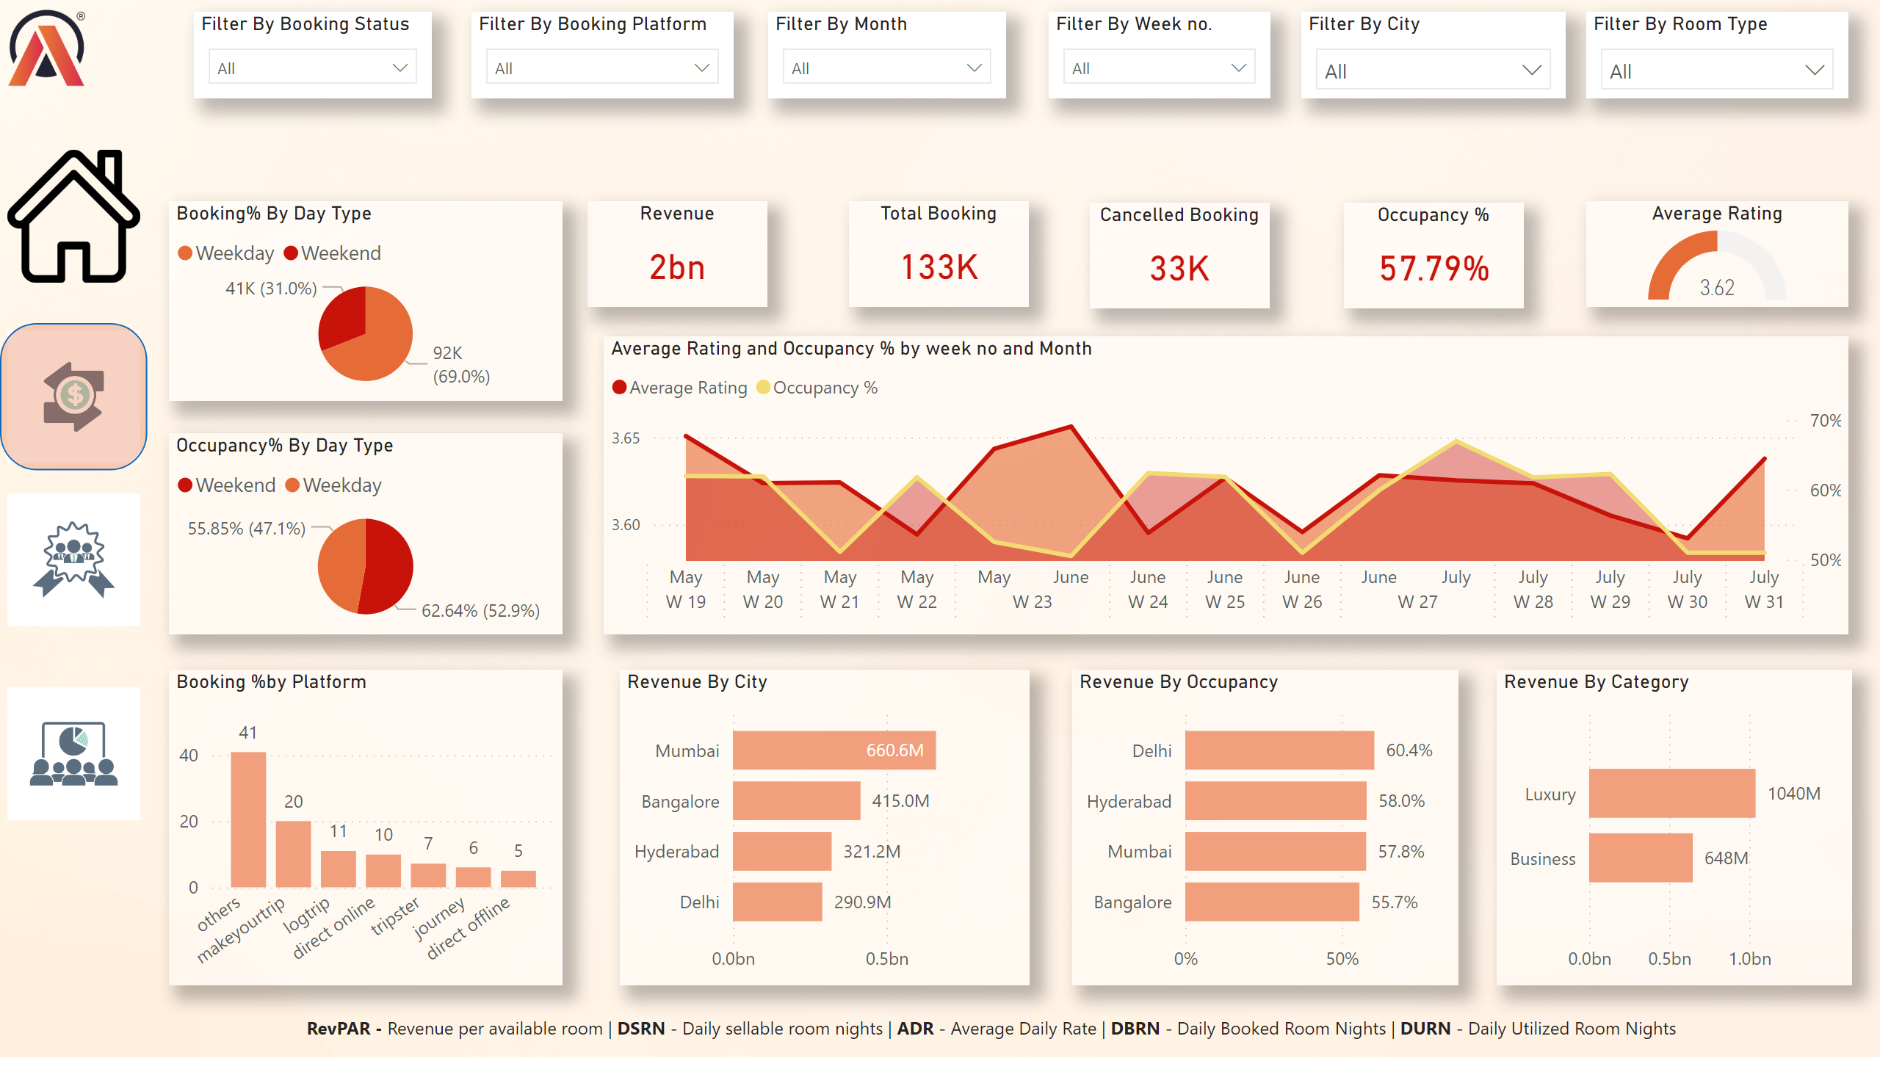
Revenue & Occupancy View
Notes:
Filter By City
No alt text provided
Filter By Room Type
No alt text provided
Filter By Month
No alt text provided
Filter By Week no.
No alt text provided
textbox
No alt text provided
Filter By Booking Status
No alt text provided
Filter By Booking Platform
No alt text provided
image
No alt text provided
Revenue By Category
No alt text provided
Booking %by Platform
No alt text provided
Revenue By Occupancy
No alt text provided
Revenue By City
No alt text provided
areaChart
No alt text provided
Average Rating
No alt text provided
Occupancy %
No alt text provided
Revenue
No alt text provided
Booking% By Day Type
No alt text provided
Occupancy% By Day Type
No alt text provided
Total Booking
No alt text provided
Cancelled Booking
No alt text provided
image
No alt text provided
image
No alt text provided
image
No alt text provided
shape
No alt text provided
image
No alt text provided

Slide 4
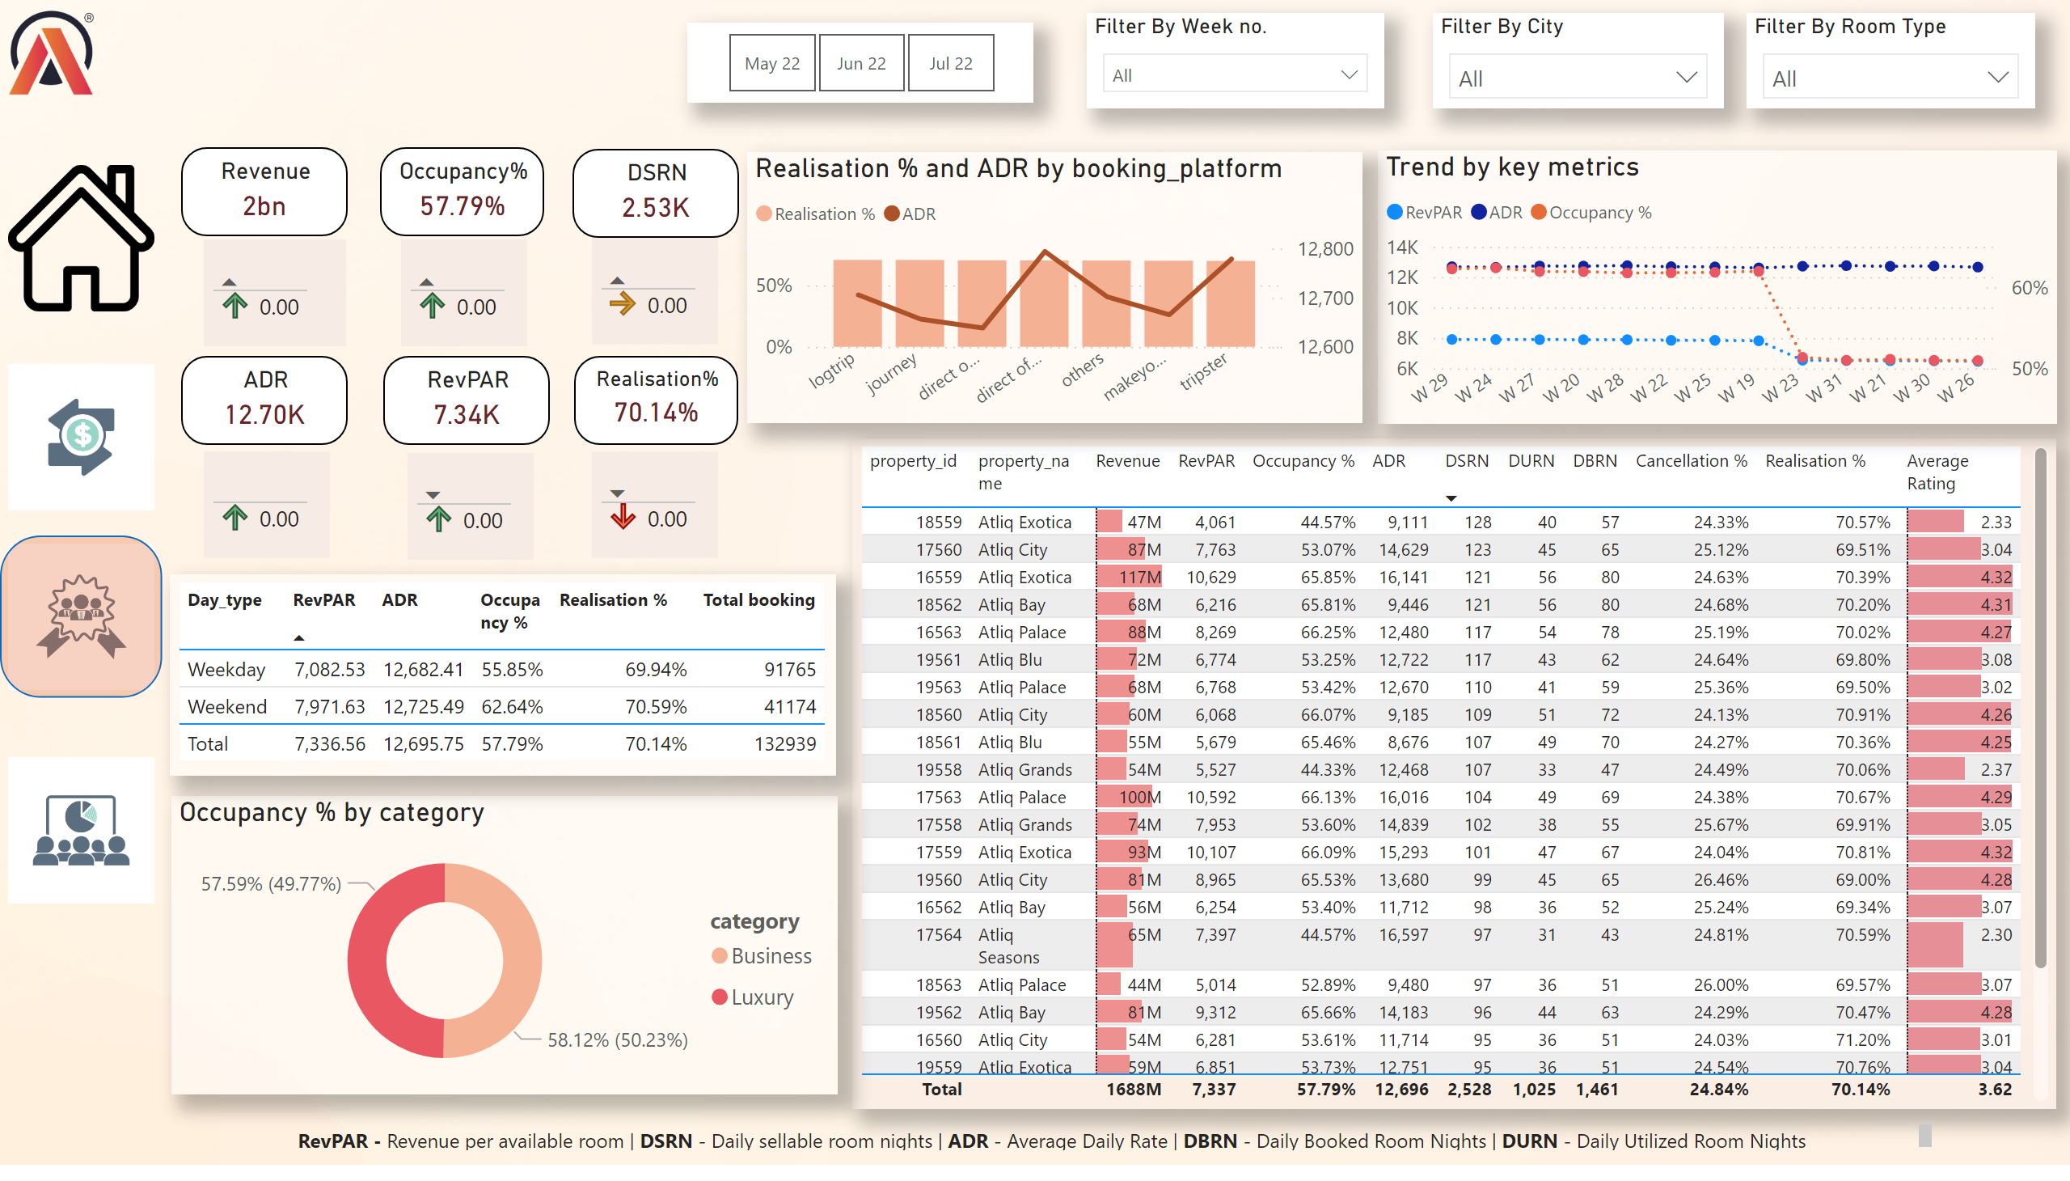
Executive View
Notes:
tableEx
No alt text provided
Filter By City
No alt text provided
Filter By Room Type
No alt text provided
slicer
No alt text provided
Filter By Week no.
No alt text provided
Revenue
No alt text provided
Occupancy%
No alt text provided
Revenue
No alt text provided
donutChart
No alt text provided
Revenue
No alt text provided
DSRN
No alt text provided
Revenue
No alt text provided
ADR
No alt text provided
Revenue
No alt text provided
RevPAR
No alt text provided
Realisation%
No alt text provided
Revenue
No alt text provided
Revenue
No alt text provided
Trend by key metrics
No alt text provided
tableEx
No alt text provided
lineStackedColumnComboChart
No alt text provided
textbox
No alt text provided
image
No alt text provided
image
No alt text provided
image
No alt text provided
image
No alt text provided
image
No alt text provided
shape
No alt text provided

Slide 5
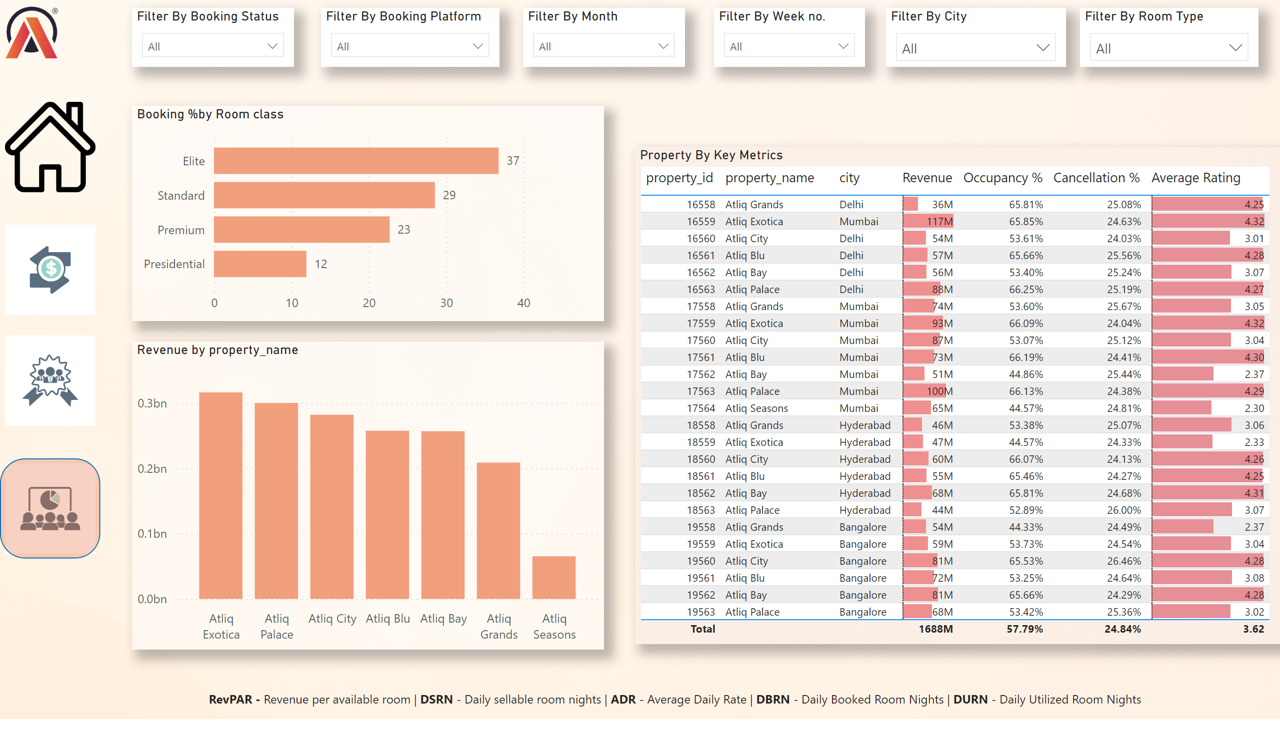
Property View
Notes:
Filter By City
No alt text provided
Filter By Room Type
No alt text provided
Filter By Month
No alt text provided
Filter By Week no.
No alt text provided
textbox
No alt text provided
Filter By Booking Status
No alt text provided
Filter By Booking Platform
No alt text provided
image
No alt text provided
Property By Key Metrics
No alt text provided
Booking %by Room class
No alt text provided
clusteredColumnChart
No alt text provided
image
No alt text provided
image
No alt text provided
image
No alt text provided
image
No alt text provided
shape
No alt text provided

